Slide 1
FUELS AND COMBUSTION
Unit-IV

Slide 2
Introduction
Fuel is a combustible substance, containing carbon as main constituent, which on proper burning gives large amount of heat. It can also be used economically for domestic and industrial purpose.
During the process of combustion of a fuel, the atoms of C, H etc. combine with O with the simultaneous liberation of heat at rapid rate.
This energy is liberated due to reaction
Fuel + O₂ → Products + Heat
Primary and main source of fuels are coals and petroleum.

Slide 3
FUELS
PRIMARY / NATURAL
SECONDARY/ DERIVED
SOLID
LIQUID
GASEOUS
SOLID
LIQUID
GASEOUS
Wood,
peat,
coal,
lignite
Crude oil,
Vegetable
oil
Natural
gas
Coke,
charcoal
Tar,
Kerosene,
Diesel,
Petrol,
Coal gas,
Bio gas,
Water gas,
LPG

Slide 4
Calorific Value
Calorific value of a fuel is the total quantity of heat liberated when a unit mass of fuel is burnet completely.
Two types: GCV and NCV
Units of heat:
Calorie – Calorie is the amount of heat required to raise the temperature of one gram of water through one degree centigrade.
Kilocalorie – The quantity of heat required to raise the temperature of one kilogram of water through one degree centigrade. 1kcal = 1000 cal
British Thermal Unit (B.Th.U.) – The quantity of heat required to raise the temperature of one pound of water through one degree Fahrenheit. 1 B.Th.U. = 252 cal
Centigrade Heat Unit – The quantity of heat required to raise the temperature of one pound of water through one degree centigrade. 1 kcal = 3.968 B.Th.U. = 2.2 C.H.U.

Slide 5
Higher or Gross and Lower or Net Calorific Value
Usually all fuels contain hydrogen and when calorific value of hydrogen containing fuel is determined experimentally, the hydrogen is converted into steam.
Higher calorific value (HCV) is the total amount of heat produced, when unit mass/volume of fuel has been burnt completely and the products of combustion have been cooled to room temperature.
In the actual use of any fuel the water vapor and moisture etc. are not condensed and escape as such along with hot combustion gases. Hence, a lesser amount of heat is available. So lower calorific value is the total amount of heat produced, when unit mass/volume of fuel has been burnt completely and the products are permitted to escape in atmosphere.

Slide 6
Relation between GCV and NCV
NCV = GCV – (0.09 × % H× Latent heat of steam)

Slide 7
Characteristic of a good fuel
High calorific value
Moderate ignition temperature
Low moisture content
Low non-combustible matter content
Moderate velocity of combustion
Products of combustion should not be harmful
Low cost
Easy to transport
Combustion should be easily controllable
Should not undergo spontaneous combustion
Storage cost in bulk should be low
Should burn in air with efficiency, without much smoke
In case of solid fuels size should be uniform

Slide 8
Comparison of solid/liquid fuels
Solid Fuels Advantages (i) Easy to transport (ii) Convenient to store (iii) Cost of production is low (iv) Moderate ignition temperature. Disadvantages (i) Ash content is high (ii) Thermal efficiency is low (iii) Burns with clinker formation (iv) Cannot be controlled easily (v) Cost of handling is high (vi) Calorific value is lower
Liquid fuels Advantages (i) Higher calorific value (ii) No dust or ash formed (iii) Firing is easier and extinguished easily by stopping the supply (iv) Easy to transport (v) Can be stored indefinitely (vi) Less excess air required (vii) Less furnace space (viii) No wear and tear (ix) Used in internal combustion engine as fuel. Disadvantages (i) Cost is higher (ii) Storage is expensive (iii) Greater risk of fire hazards

Slide 9
BOMB CALORIMETER
Principle : Heat released by Fuel = Heat gained by Water + Calorimeter
The calorific value of the fuel is calculated from the measured data.
Bomb pot : a) Electrodes and Fuse wire
b) Cup / Crucible
2) Calorimeter/Water bath : A) Thermometer : Beckmann's
B) Stirrer
3) Air and water Jackets
4) Accessories: Oxygen cylinder, pellet press, D.C. battery

Slide 10
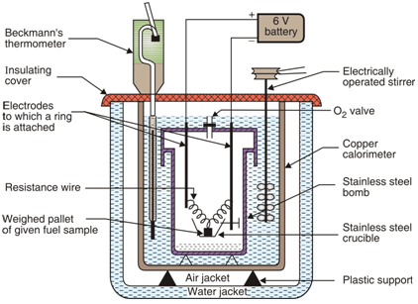
Bomb calorimeter

Slide 11

Bomb Calorimeter
Observations:
mass of fuel in gm = x gm
mass of water in calorimeter = W gms
Water equivalent of calorimeter set = w gms.
Gross Calorific value of fuel = L calories/gm
Rise in temperature of water = (t₂ – t₁)
Heat liberated by burning fuel = Heat absorbed by water and calorimeter.

Slide 12
Corrections in formula
Fuse wire correction : The fuse wire used gets burnt.
(ii) Acid correction: Fuels containing sulphur and nitrogen are oxidized under high pressure and temperature of ignition to sulphuric acid and nitric acid.
S + 0₂ → SO₂
2S0₂ + 0₂ + 2H₂0 → 2H₂S0₄ ∆H = -144000 cal
2N₂ + 2H₂0 + 5O₂ → 4HN0₃ ∆H = - 57160 cal
Formation of these acids is an exothermic reaction, thus the measured heat also includes the heat given out during acid formation.
(iii) Cooling correction: Time taken to cool the water from maximum temperature to room temperature is noted. From the rate of cooling (dt0 /min) and actual time for cooling (t min), the cooling correction dt x t is added to rise in temperature.

Slide 13
The water equivalent of the calorimeter is determined by burning a fuel of known calorific value and using the above equation.
Fuel used for this purpose with std. GCV are:
and naphthalene = 9688 cal/g
Camphor = 9292 cal/g
benzoic acid = 6325 cal/g
Salicylic acid = 5269 cal/g

Slide 14
Wood and Coal as Fuel
Wood is obtained from forest. Freshly cut wood contain 25-50% moisture, which is reduced to about 15% on air-drying. [composition of wood: C = 55%, H = 6%, O = 43% and ash = 1%]. The calorific value of air-dried wood is about 3500-4500 kcal/kg.
Coal (from the Old English term col, which has meant "mineral of fossilized carbon" since the 13th century) is a combustible black or brownish-black sedimentary rock usually occurring in rock strata in layers or veins called coal beds or coal seams. The harder forms, such as anthracite coal, can be regarded as metamorphic rock because of later exposure to elevated temperature and pressure. Coal is composed primarily of carbon along with variable quantities of other elements, chiefly hydrogen, sulfur, oxygen, and nitrogen.

Slide 15
Solid Fuels
Coal
Coal is a highly carbonaceous matter that has been formed as a result of alteration of vegetable matter (e.g., plants)
under certain favorable conditions.
It mainly composed of C, H, N, and O, alongwith
non-combustible inorganic matter
Wood →Peat →Lignite →Bituminous coal →Anthracite
Changes in Properties from peat to Anthracite are
C %, calorific value, hardness, density, lusture, intensity of black colour
Moisture content, volatile matter, ash, O, N, H and S %

Slide 16
Classification of coal
As geological processes apply pressure to dead biotic material over time, under suitable conditions it is transformed successively into:
Peat –the first stage in the coalification of wood. It is uneconomical fuel, since it may contain as much as 80-90 % water but on air drying it burns freely.
The average composition of air dried peat is :
C = 57%, H = 6%, ash content = 2.5-6%.
Its calorific value is about 5400 kcal/kg.
Lignite – It is soft, brown colored variety of lowest rank coal, which consist of vegetable mater decomposed more than that in peat.
Lignite is compact in texture, containing 20-60 % moisture.
Air dried lignite contains : C = 60-70%, oxygen = 20%.
Its calorific value is about 6500-7100 kcal/kg.

Slide 17
Classification continued……
Bituminous coal (common coal) – The carbon content varies from 75-83% and the calorific value 7000-8600 kcal/kg.
Bituminous coals are three types:
Sub-bituminous
Bituminous
Semi-bituminous
Anthracite – Anthracite is a class of highest rank coal containing 92-98% carbon and lowest volatile matter and moisture content. The calorific value is about 8650-8700 kcal/kg

Slide 18
Analysis of Coal
To access the quality of coal, two types of analysis are made:
Proximate analysis
Moisture
Volatile matter
Ash
Fixed carbon
Ultimate analysis
Carbon and hydrogen
Nitrogen
Sulfur
Ash
Oxygen

Slide 19


Proximate Analysis
Moisture – About 1 g of finely powdered air-dried coal sample is weighed in a crucible. The crucible is heated in an electric hot air oven at 105-110°C for 1 hr. Cooled in desiccators and weighed.
Volatile matter – Dried sample after moisture analysis is then covered with lid and placed in muffle furnace at 925 ± 20 °C. The crucible is taken out of the oven after 7 minutes of heating, cooled and weighed.
Ash – The residual sample is then heated without lid in muffle furnace at 700 ± 50 °C for ½ hours. Then cooled and weighing is repeated, till a constant weight is obtained.
Fixed carbon –
% of fixed carbon = 100 - % of (moisture + volatile matter + ash)

Slide 20
Importance of Proximate analysis
1. Moisture
(i) Decreases calorific value of coal largely as it does not burn and takes away heat in the form of latent heat.
(ii) It increases ignition point of coal.
Hence, a coal with lower moisture % is better quality.
2. Volatile Matter
(i) It decreases calorific value of coal.
(ii)It elongates flame and decreases flame temperature.
(iii)It forms smoke and pollutes air.
the coal with lesser V.M. is better quality coal.
3.Ash
(i)Ash reduces calorific value of coal as ash is non-burning part in coal.
(ii)Ash disposal is a problem.
(iii)Ash fuses to form clinker at high temperature, obstructing the air supply to coal burning in furnace.
Hence, lesser the ash %, better is the quality of coal.
4.Fixed Carbon
Carbon is the burning part in coal and higher the FC%, higher is calorific value. Hence a good quality coal contains high FC%.

Slide 21
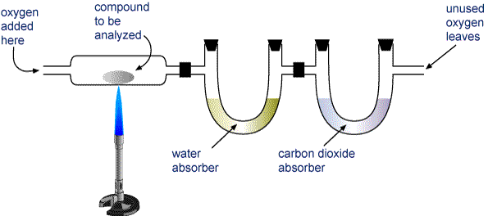


Ultimate Analysis
Carbon and Hydrogen
About 1-2 g of accurately weighed coal sample is burnet in a current of oxygen in a combustion apparatus. C and H of the coal are converted into CO₂ and H₂O respectively. The gaseous products of combustion are absorbed respectively in KOH and CaCl₂ tubes of known weight. The increase in weight of these are then determined.
C + O₂ → CO₂ H₂ + ½ O₂ → H₂O
CO₂ + 2KOH → K₂CO₃ + H₂O
7H₂O + CaCl₂ → CaCl₂.7H₂O

Slide 22

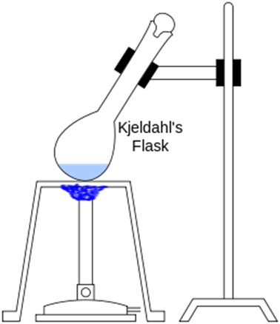
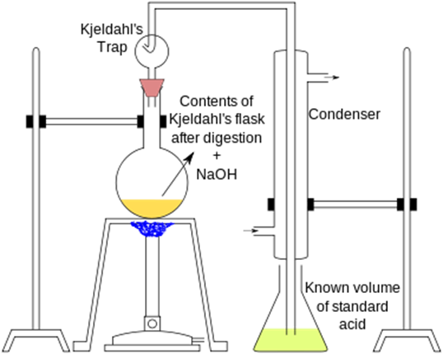
Nitrogen
About 1 g of coal is heated with H₂SO₄ along with K₂SO₄ in a Kjeldahl’s flask. When solution become clear, excess of NaOH is added and the liberated ammonia passed in a known volume of standard acid solution. The unused acid is then determined by back titration with standard NaOH solution. From the volume of acid consumed by ammonia liberated, the percentage of N in coal is calculated as follows:
Coal (N) + H₂SO₄ → (NH₄)₂SO₄ + CO₂ + SO₂ + H₂O
(NH₄)₂SO₄ + 2NaOH → Na₂SO₄ + 2NH₃ + 2H₂O
2NH₃ + H₂SO₄ → (NH₄)₂SO₄

Slide 23

Sulphur
Sulphur is determined from the washings obtained from the known mass of coal, used in a bomb calorimeter for determination of calorific value. The washings are treated with barium chloride solution, barium sulphate is precipitated. The precipitate is filtered, washed and dried.
Ash –
Same as proximate analysis
Oxygen –
% 0f O = 100 - % of (C + H + S + N + ash)

Slide 24
Importance of Ultimate analysis
C and H in coal directly contribute towards the calorific value of the coal. Higher the percentage of C and H, better is the quality of the coal and higher is its calorific value.
Nitrogen in the coal does not contribute any useful value to the coal. Since it is generally present in small quantities (~ 1%) its presence is not of much significance. A good quality coal should have very little nitrogen content.
Sulphur containing coal is not suitable for the preparation of metallurgical coke as it adversely affects the properties of the metal. Oxides of sulphur pollutes the environment and leads to corrosion.
The lower the oxygen content, the more is the maturity of coal and greater is its calorific value

Slide 25
Types of Carbonization of Coal
There are two types of carbonization:
Low-temperature carbonization – In this process, the heating of coal is carried out at 500-700°C.The yield of coke is about 75-80% and it contain about 5-15 % volatile matter. It is not mechanically strong, so it cannot be used as metallurgical coke. (heating value is 6500-9500kcal/m³)
High-temperature carbonization – It is carried out at 900-1200°C with the object of producing coke of the right porosity, hardness, purity, strength etc. so it can be used in metallurgy. (heating value is 5400-6000kcal/m³)

Slide 26
Liquid Fuels
Petroleum (Crude oil)
An important primary liquid fuel.
It is a dark greenish-brown viscous oil found deep in the
earth’s crust.
It is formed millions of years ago by anaerobic decay of
of debris of plants and animals (which are buried due to
volcanoes) under the influence of high temp. and pressure.
Organic debris convert into alkanes, which on isomerisation,
cycisation form crude oil.

Slide 27
COMPOSITION OF CRUDE OIL
Elemental composition:
Molecular composition
Element | Percent range
Carbon | 80 to 87%
Hydrogen | 11 to 15%
Nitrogen | 0.4 to 0.9%
Oxygen | 0.1 to 0.9%
Sulfur | 0.1 to 3.0%
Metals | < 0.1%
Alkanes
cycoalkanes
aromatics
Asphaltenes
Resins

Slide 28
Refining of petroleum
Refining or fractionation is the process of separation of various fractions from crude oil, on the basis of fractional distillation. The crude oil contains a large number of hydrocarbons but by the process of refining, they are divided into few groups of molecular weights or boiling point ranges.
The refining consists of 3 STEPS-
(i) Removal of water (by Cottrell’s process ): First the emulsified water along with salts dissolved, is removed by passing the crude oil between highly charged electrodes. The colloidal water droplets unite on positive electrode to form large drops which separate from oil.

Slide 29
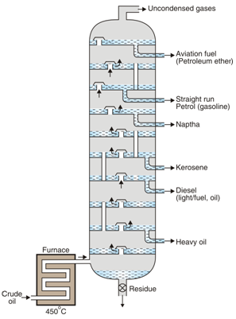
Refining continued………..
(ii) Removal of sulphur : Then the crude oil is treated with hot CuO to remove sulphur from the sulphur compounds in crude oil.
(iii) Fractionation : The principle of fractional distillation is that the vapours of higher boiling point compounds first get condensed into liquid, during the stepwise cooling. Various useful fractions like petrol, diesel, kerocene etc. are obtained by fractionation.

Slide 30
Working
The crude oil is heated at about 400°C in a furnace. Vapours enter into the fractionating column at the bottom.
The vapours travel upwards through the bubble cups and gradually get cooled. The vapours of organic compounds with higher b.p. get condensed in bubble cups and the liquid deposits on the trays.
The uncondensed vapours rise up and get condensed in upper trays.
From various trays, the fractions like petrol, diesel, kerocene, naphtha, heavy oil etc. are taken out. Finally a small part of vapours comes out as uncondensed gases from the top at about 40°C.
Heavy oil fraction can be further fractionated to get lubricating oils, vaseline, wax. The petrol obtained from refinery is called as straight run petrol but is not a good quality petrol.
•

Slide 31
Cracking
Cracking is defined as the process of decomposition of higher molecular weight hydrocarbons (higher boiling) into lower molecular weight hydrocarbons (low boiling).
The rate of cracking and the end products are strongly dependent on the temperature and presence of catalysts.
C₁₀H₂₂ → C₅H₁₂ + C₅H₁₀
Cracking process involves breaking of C-C and C-H bonds.
It produces low boiling alkanes and alkenes.
A small amount of carbon and hydrogen are also produced.
It is possible to convert any higher boiling fraction into petrol or LPG by the process of cracking.

Slide 32
TYPES OF CRACKING
CRACKING
THERMAL CRACKING
CATALYTIC CRACKING
LIQUID PHASE
VAPOUR PHASE
FIXED BED
MOVING BED

Slide 33
Knocking of IC engine
A petrol engine produces cracking noise and vibration together called as ‘knocking’.
Petrol vapours entered in engine alongwith air burn instantly (small explosion) with the firing of spark.
The tendency to knock depends not only upon the quality of petrol but also on the engine design and conditions of engine run, compression ratio.

Slide 34
Octane Number
Graham Edger proposed an arbitrary scale for expressing the
knocking characteristics of gasoline in combustion engine as
octane number in 1972 on the basis of antiknock properties.
It has been found that n-heptane, CH₃-CH₂-CH₂-CH₂-CH₂-CH₂-CH₃,
knocks very badly and hence, its antiknock value has been arbitrarily
given zero. On the other hand, iso-octane (2,2,4 –trimethylpentane)
gives very little knocking, so its antiknock value is given as 100.
Thus, Octane number (or rating) of a gasoline (or any other internal
combustion engine fuel) is the percentage of iso-octane in a mixture
of iso-octane and n-heptane, which matches the fuel under test in
knocking characteristics.

Slide 35
Aromatics > Cycloalkanes > alkenes > Br. alkane > n-alkane
Anti-knocking Agents
The octane rating of gasoline samples can be increased by the addition of certain organometallic compounds called anti-knocking agents and the process is called “doping”.
An extensively used anti-knocking agent is tetraethyl lead Pb(C₂H₅)₄ 0.5ml/litre. (but it causes air pollution by Pb.)
Addition of alkylate fraction to petrol i.e. branched chain alkane of higher mol. wt.
Addition of benzene, toluene, xylene (BTX) to petrol.
Addition of methyl t-butyl ether (MTBE) or ethyl t-butyl ether.
Adjusting suitable compression ratio.

Slide 36
Quality of petrol can be improved by adding:
Unleaded Petrol
Petrol wherein the enhancement of octane rating is accomplished without the addition of lead compounds is referred to as unleaded petrol.
Antioxidant to improve oxidation resistance.
Octane no. improvers like BTX, MTBE.
freezing point depressant like ethanol, glycol to minimize ice formation in fuel line in cold regions.
Detergents like fatty amines to clean fuel line and carburetor.

Slide 37
Advantages of unleaded petrol
The harmful effects of discharge of poisonous lead and its compounds through the exhaust of automobiles is avoided.
One of the major advantages of using unleaded petrol is that it permits the attachment of a catalytic converter to the exhaust pipe in automobiles.
Catalytic converter contains rhodium catalyst.
It converts the toxic gases such as CO and NO to harmless CO₂ and N₂.
It also oxidizes hydrocarbons into CO₂ and H₂O.
Leaded petrol cannot be used in automobiles equipped with catalytic converter as the lead present poisons the catalyst thus destroying the active sites.

Slide 38
Cetane number
Cetane number or CN is a measurement of the combustion quality of diesel fuel during compression ignition. It is a significant expression of the quality of a diesel fuel.
Cetane number is a measure of a fuel's ignition delay, the time period between the start of injection and the first identifiable pressure increase during combustion of the fuel. In a particular diesel engine, higher cetane fuels will have shorter ignition delay periods than lower cetane fuels.
The suitability of a diesel fuel is determined by its cetane value which is the percentage of n-hexadecane in a mixture of n-hexadecane and
2-methyl naphthalene, which has the same ignition characteristics as the diesel sample.

Slide 39
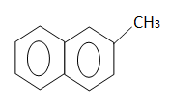
Cetane no. continued….
CH₃-(CH₂)₁₄-CH₃
2-Methyl napthalene
Cetane no. 0
n-Hexadecane / Cetane
Cetane no. 100
Order of relative cetane no. values
n-alkanes > cycloalkanes > alkenes > branched alkanes > Aromatics

Slide 40
how to increase cetane no.
Alkyl nitrates (principally 2-ethylhexyl nitrate) and di-tert-butyl peroxide are used as additives to raise the cetane no.
Antioxidant to improve oxidation resistance during storage.
lubricity additives for lubrication of fuel injection system.
Detergents to clean fuel line and carburetor.

Slide 41
Power alcohol
When ethyl alcohol is used as fuel in internal combustion engine,
around 5-25% with petrol, it is called as power alcohol.
diastage
maltase
2(C₆H₁₀O₅₎ + nH₂O n(C₁₂H₂₂O₁₁₎ n(C₆H₁₂O₆₎ _{Starch} _{Maltose} glucose
C₁₂H₂₂O₁₁ + H₂O C₆H₁₂O₆ + C₆H₁₂O₆
glucose fructose
C₂H₅OH + 2CO₂
invertase
Zymase

Slide 42
Advantages of Power Alcohol
(i) Ethyl alcohol has good antiknocking property and its octane number is 90, Addition of ethanol to petrol, increases its octane number.
(ii) It has property of absorbing any traces of water if present in petrol.
(iii) If a specially designed engine with higher compression ratio is used, then the disadvantage of lower C.V. of ethyl alcohol can be overcome.
(iv) Ethyl alcohol contains ‘O’ atoms, which help for complete combustion of power alcohol and the polluting emissions of CO, hydrocarbon, particulates are reduced largely.
(v) Use of ethyl alcohol in petrol reduces our dependence on foreign countries for petrol and saves foreign currency considerably.
(vi) Power alcohol is cheaper than petrol.

Slide 43
Disadvantages of Power Alcohol
(i) Ethyl alcohol has C.V. 7000 cal/gm much lower than C.V. of petrol 11500 cal/gm. It’s use reduces power output upto 35%.
(ii) Ethyl alcohol has high surface tension and its atomisation, especially at lower temperatures, causes starting trouble.
(iii) Ethyl alcohol may undergo oxidation to form acetic acid, which corrodes engine parts.
(iv) Ethyl alcohol obtained by fermentation process directly cannot be mixed with petrol but it has to be dehydrated first.
(v) As ethyl alcohol contains ‘O’ atoms, the amount of air required for complete combustion of power alcohol is lesser and therefore carburettor and engine needs to be adjusted or modified, when only ethyl alcohol is used as fuel.

Slide 44
Bio-diesel
It is a renewable fuel, composed by fatty acid methyl (or ethyl) esters, produced by a transesterification reaction between vegetable oil or animal fats and methanol (or ethanol) using Na metal or CH₃ONa as catalyst.
Transestrification is a process of converting one ester into another ester.
During the reaction we get water soluble glycerol and a small amount of sodium soaps. The water soluble part is easily separated by washing the mixture with water and biodiesel is left behind.
Compounds present in biodiesel are like,
methyl palmitate H ₃C - (CH₂)₁₄ - COOCH₃
methyl stearate H₃C - (CH₂)₁₆ - COOCH₃
methyl oleate H₃C - (CH₂)₇ - CH = CH - (CH₂)₇ - COOCH₃
methyl linoleate H₃C - (CH₂)₅ - (CH = CH)₂ - (CH₂)₇ - COOCH₃

Slide 45
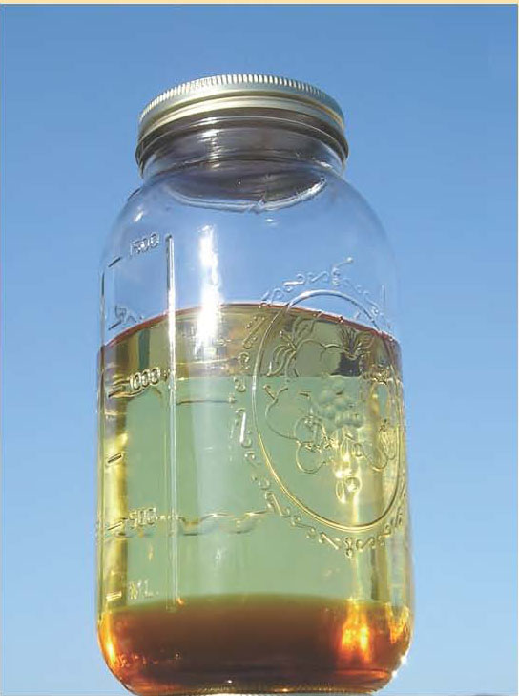
Preparation reaction
CH₂ – COOR₁ R₁COOCH₃ CH₂OH
+
CH - COOR₂ +3 CH₃OH R₂COOCH₃ + CHOH
+
CH₂ - COOR₃ R₃COOCH₃ CH₂OH
CH₃ONa
Products of Reaction are Biodiesel and glycerol
Why do They separate?
As they are immiscible
phases, we can easily drain
off the glycerine and
biodiesel is left behind.
Biodiesel
Glycerine

Slide 46
Advantages of Biodiesel
(i) Biodiesel is cheaper, as it is manufactured from cheap, nonedible or waste oil or animal fats.
(ii) It has high cetane numbers 46 to 54 and high C.V. of about 40 kJ/gm.
(iii) It is regenerative and environment friendly.
(iv) It does not give out particulate and CO pollutants, as 0 atoms in biodiesel help for complete combustion.
(v) It has certain extent of lubricity, due to higher oiliness of the esters.
(vi) Its use provides good market to vegetable oils and reduces our dependence on diesel on foreign countries, saving currency.
(vii) It is clean to use biodiesel in diesel engines.

Slide 47
Disadvantages of biodiesel
Lower Energy Content
8% fewer BTU’s per gallon, but also higher cetane #, lubricity, etc.
Poor cold weather performance
This can be mitigated by blending with diesel fuel or with additives, or using low gel point feedstocks such as rapeseed/canola.
Stability Concerns
Biodiesel is less oxidatively stable than petroleum diesel fuel. Old fuel can become acidic and form sediments and varnish. Additives can prevent this.
Scalability
Current feedstock technology limits large scalability
Notes:
Btu/lb Btu/gal
No. 2 Diesel 18,300 129,050
B100 16,000 118,170
(12.5% less) (8% less)

Slide 48
Gaseous Fuels
Natural Gas
Composition : Average composition of a natural gas is;
CH₄ C = 80 – 88 % ₂H₆ = 4 – 6 %
C₃ H₈ C = 3 – 4 % ₄ H₁₀ = 1 – 4 %
C₅ and C⁺₅ hydrocarbons = 0.5 – 8 %
Natural gas is also associated with 5 – 10 % of NH₃, CO₂, CO, H₂O, H₂, H₂S, N₂.

Slide 49
COMPRESSED NATURAL GAS (CNG)
CNG is natural gas compressed to a high pressure of about 1000 atmospheres.
A steel cylinder containing 15 kg of CNG contains about 2 x 104 L or 20 m3 of natural gas at 1 atmospheric pressure. It is derived from natural gas and the main constituent of CNG is methane.
Properties:
1) CNG is comparatively much less pollution causing as it produces less CO,
ozone and hydrocarbons during combustion.
2) During it s combustion, no sulphur and nitrogen gases are evolved.
3) No carbon particles are ejected during combustion.
4) It is less expensive than petrol and diesel.
5) The ignition temperature of CNG is 550 C.
6) CNG is a better fuel than petrol/diesel for automobiles.
7) CNG requires more air for ignition.
Uses:
As CNG is the cheapest, cleanest and least environmentally impacting alternative
fuel. In Delhi, it is mandatory for all buses, taxis and auto to use CNG as a fuel.

Slide 50
LPG
Composition : LPG mainly contains propane and butanes along with little pentanes, hexanes.
Properties :
1) LPG has C.V. about 25000 cal/lit.
2) To know the leakage of LPG from cylinder, a small amount of organic sulphur compound is mixed in LPG. The mercaptan or thioether has characteristic smell.
3) It burns with blue flame and it is clean to use.
Uses : LPG is used as domestic fuel, industrial fuel. LPG is useful as motor fuel.

Slide 51
Calculation of Air requirement
Substances always combine in definite proportions. These proportions are determined by their molecular masses.
C + O₂ → CO₂ (12:32:44)
22.4 L of any gas at 0°C and 760mm pressure (STP) has a mass equal to its 1 mol.
Air contain 21% of oxygen by volume and 23% of oxygen by mass, hence from the amount of oxygen required by the fuel the amount of air can be calculated:
1 kg of oxygen is supplied by 1×100/23 = 4.34 kg of air
1 m³ of oxygen is supplied by 1×100/21 = 4.76 m³ of air
28.94 g/mol is taken as molar mass of air.

Slide 52
Calculation continued……
Minimum oxygen required for combustion = Theoretical oxygen required – oxygen present in the fuel
Minimum oxygen required should be calculated on the basis of complete combustion.
If the combustion products contain CO and O₂, then excess O₂ is found by subtracting the amount of O₂ required to burn CO to CO₂.
The mass of any gas can be converted to its volume at certain temperature and pressure by assuming that the gas behaves ideally and using the equation: PV = nRT

Slide 53
Thank you

